Slide 1

Introduction to Transport Layer
Lecture 4 | CSE421 – Computer Networks
Department of Computer Science and Engineering
School of Data & Science

Slide 2

Objectives
Our goals:
understand principles behind transport layer services
learn about two transport layer protocols:
  UDP: User Datagram Protocol
  TCP: Transmission Control Protocol

Slide 3
Transport vs. Network layer
transport layer: logical communication between processes
network layer: logical communication between hosts
household analogy:
12 kids in Ann’s house sending letters to 12 kids in Bill’s house:
processes = kids
app messages = letters in envelopes
hosts = houses
transport protocol = Ann and Bill
network-layer protocol = postal service
Segments: Transport Layer PDU

Slide 4
Functions of the Transport Layer
Primary responsibilities:
  Segmenting the data and managing each piece.
  Reassembling the segments into streams of application data.
  Identifying the different applications.
  Multiplexing
  Initiating and terminating a connection.
  Performing flow control between end users.
  Enabling error recovery.
Reliability

Slide 5


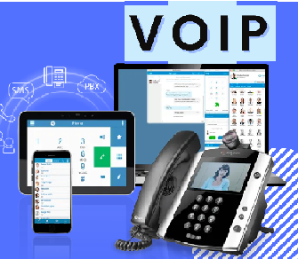
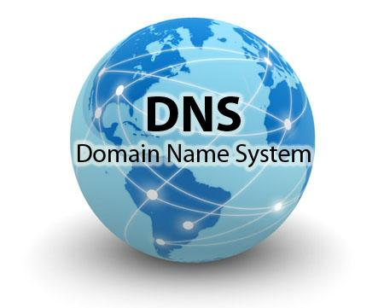

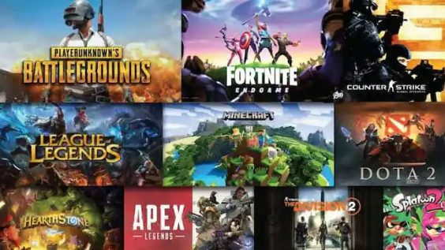
Different Applications
Different Requirements
Web Applications
Emails
Online Games
Some applications need their data to be complete with no errors or gaps.
But can accept a slight delay to ensure this.
Some applications can accept occasional errors or gaps in the data.
But they cannot accept any delay.

Slide 6
Solution : Two transport protocols?
Web Applications
Reliable
TCP
Emails
Fast
UDP
Online Games

Slide 7
UDP: User Datagram Protocol [RFC 768]
UDP : User Datagram Protocol
  Best Effort Service
  Used by applications that requires no delay in data delivery
How does UDP deliver fast?
  no connection establishment (which can add delay)
  small header size
  no error or flow or congestion control: UDP can blast away as fast as desired

Slide 8
User Datagram Protocol (UDP)
UDP is used by:
  streaming multimedia apps (loss tolerant, rate sensitive)
  SNMP
  But sometimes ……
  DNS
  HTTP/3
reliable transfer over UDP:
  add reliability at application layer
  application-specific error recovery!

Slide 9
Functions of the Transport Layer
Primary responsibilities:
  Segmenting the data and managing each piece.
  Reassembling the segments into streams of application data.
  Identifying the different applications.
  Multiplexing
  Establishing and terminating a connection
  Enabling error recovery.
  Performing flow control between end users.
UDP &TCP
Only TCP

Slide 10
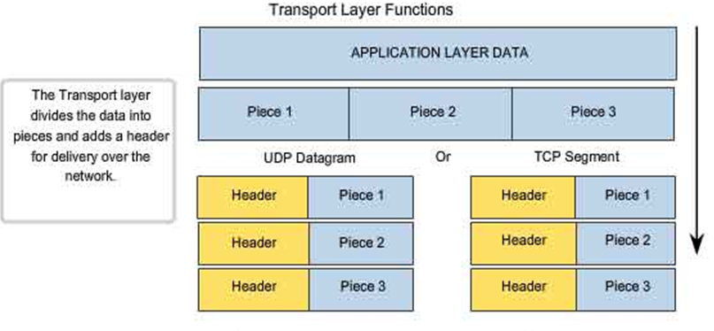
Function 1&2 – Segmentation and Reassembly

Slide 11
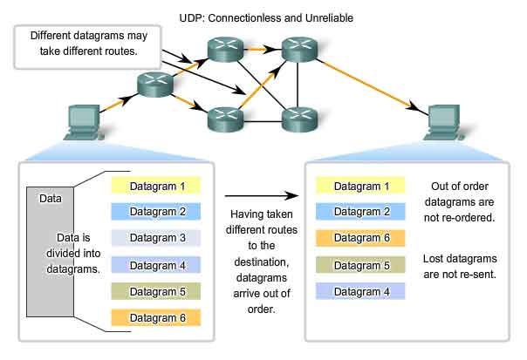
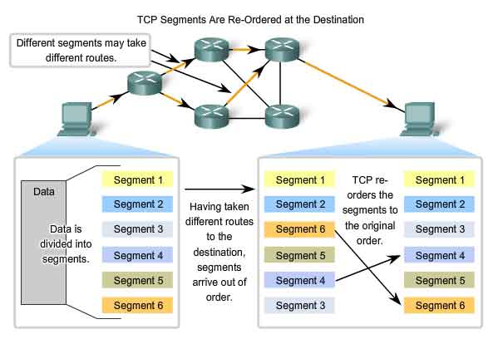
Function 2 – Reassembly
UDP
TCP

Slide 12

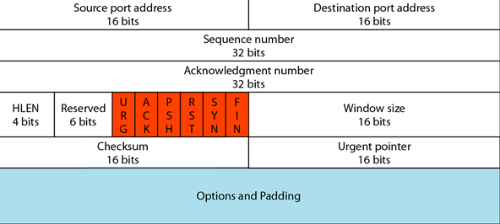
TCP and UDP Headers
UDP HEADER
TCP HEADER

Slide 13
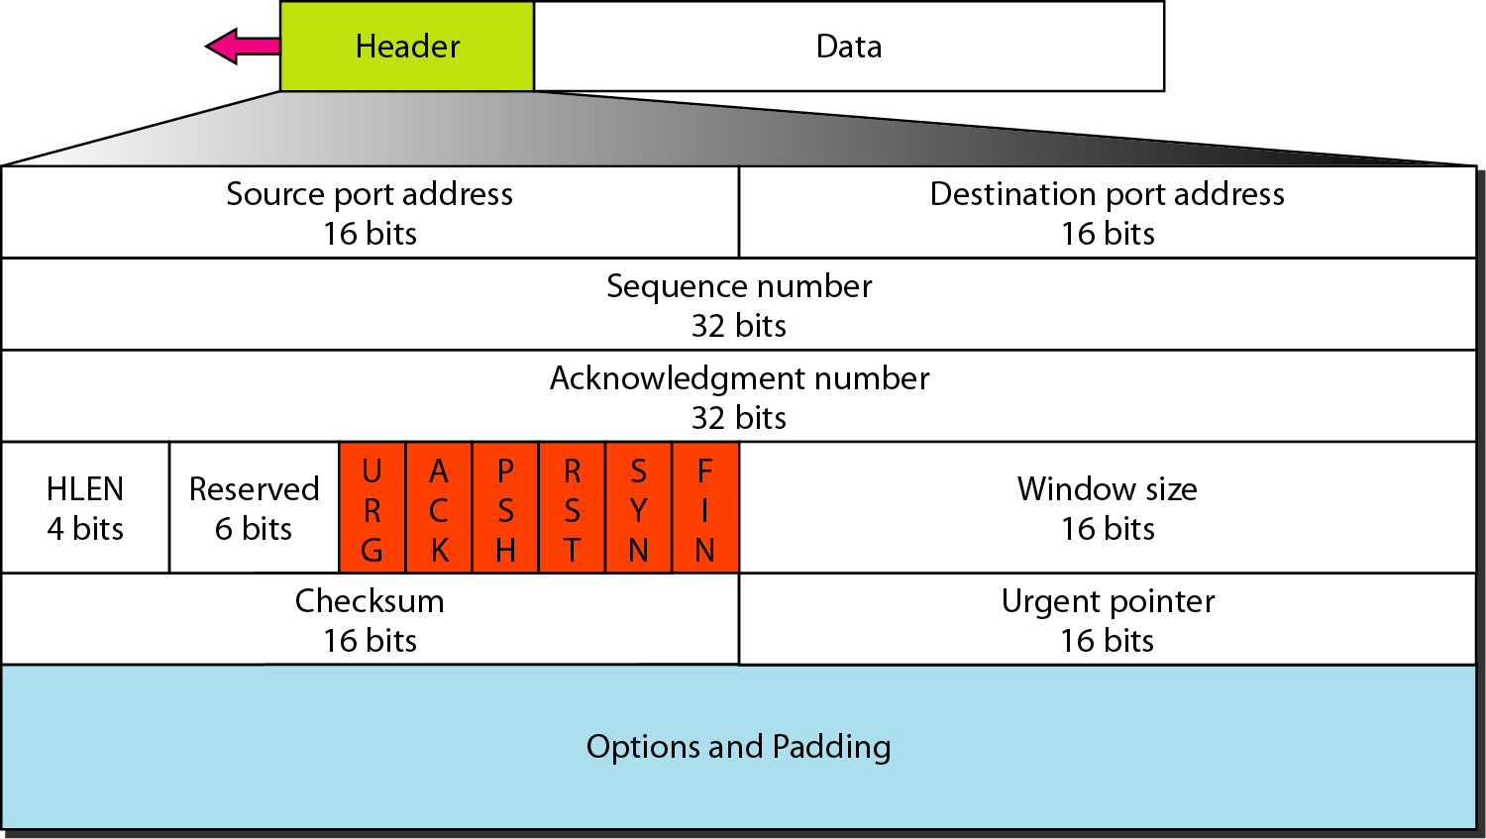
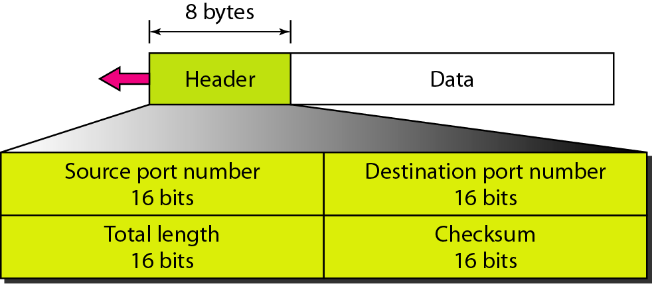
TCP and UDP Headers
TCP Header
UDP Header

Slide 14
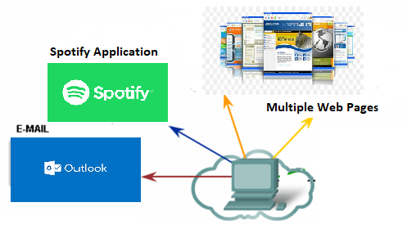
Function 3 – Identifying Different Applications
Port Numbers/Addresses are used to identify different applications/processes running in a computer
16-bits in length
  Represented as one single decimal number
  Range 0 - 65535
  e.g. 80 – Web
  25 – SMTP
  4070 – Spotify

Slide 15
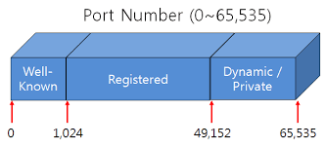
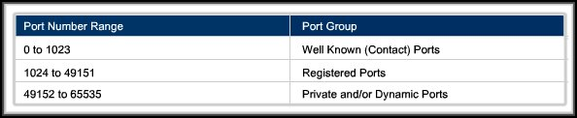
Port Numbers
Internet Corporation for Assigned Names and Numbers (ICANN) assigns port numbers
Three categories:

Slide 16
Port Number Types
Well-Known Ports:
  Assigned and controlled by IANA for standard services
  Commonly used by system processes and standardized services and applications.
67&68 – DHCP
443 – HTTPS
25 – SMTP
123 – NTP
80 – HTTP
110 – POP3
143 – IMAP
53 - DNS

Slide 17
Port Number Types
Registered Ports:
  Assigned by IANA but for specific applications requested by developers or organizations.
  Can be registered for a lot of not-so-well-known, especially corporate/proprietary protocols.
8008 – Alternate HTTP
23399 – Skype
8080 – Alternate HTTP
4070 – Spotify
5060 – SIP (VoIP)
3306 – MySQL

Slide 18
Port Number Types
Dynamic Ports:
  Also known as private or ephemeral ports
  Never assigned or controlled by IANA.
Dynamic port usage will become clearer as we move through the material.

Slide 19
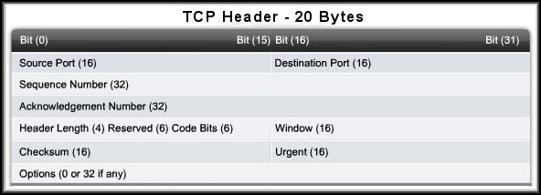
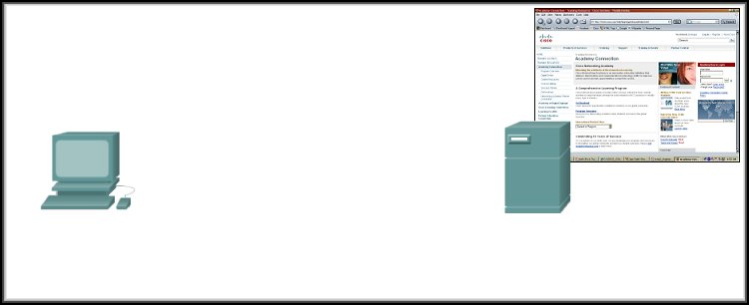
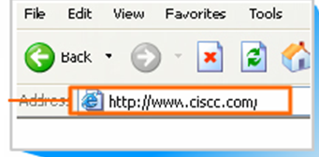
More on Port Numbers
Source = 49650
Destination = 80
Cisco.com Server
Server is listening on Port 80 for HTTP connections.
The client sets the destination port to 80 and uses a dynamic port as its source.

Slide 20
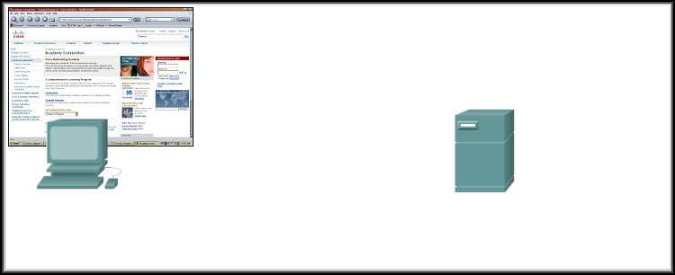
Port Numbers in Action
Source = 80
Destination = 49650
Server replies with the web page.
  Sets the source port to 80 and uses the client’s source port as the destination.

Slide 21
Port Numbers in Action
Source = 49650
Destination = 80
Source = 80
Destination = 49650
Clients can use any random port number, Servers can’t.
  Because clients won’t be able to identify server process otherwise
  Servers thus must use well-known port numbers!

Slide 22
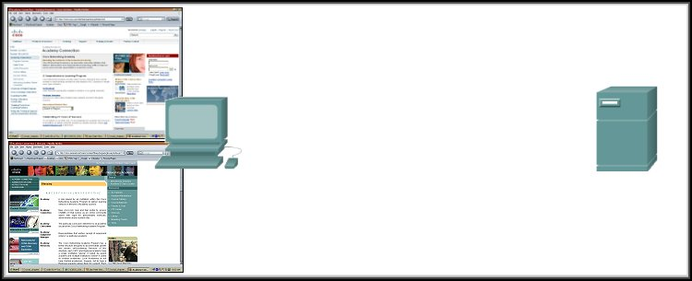
Port Numbers in Action
Source = 49650
Destination = 80
Source = 80
Destination = 49650
172.16.230.5
207.22.146.33
Source = 49655
Destination = 80
Source = 80
Destination = 49655
What if there are two sessions to the same server?
  The client uses another dynamic port as its source and the destination is still port 80.
  Different source ports keep the sessions unique on the server.

Slide 23
Port Numbers in Action
Source = 49650
Destination = 80
Source = 80
Destination = 49650
172.16.230.5
207.22.146.33
Source = 49655
Destination = 80
Source = 80
Destination = 49655
There are two tabs in the same PC, then?
  The client uses another dynamic port as its source and the destination is still port 80.
  Different source ports keep the sessions unique.

Slide 24

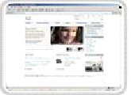

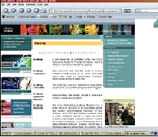
More on Port Numbers in Action
Source = 49650
Destination = 80
172.16.230.5
Source = 49650
Destination = 80
207.22.146.33
172.16.230.6
How does the Server’s Transport Layer keep them separate?
  The socket (IP Address:Port)
172.16.230.5:49650
172.16.230.6:49650
207.22.146.33:80
207.22.146.33:80

Slide 25
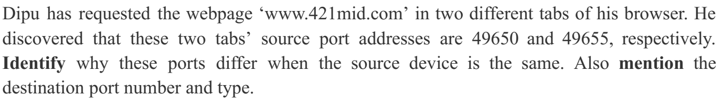
Port Numbers in Action

Slide 26
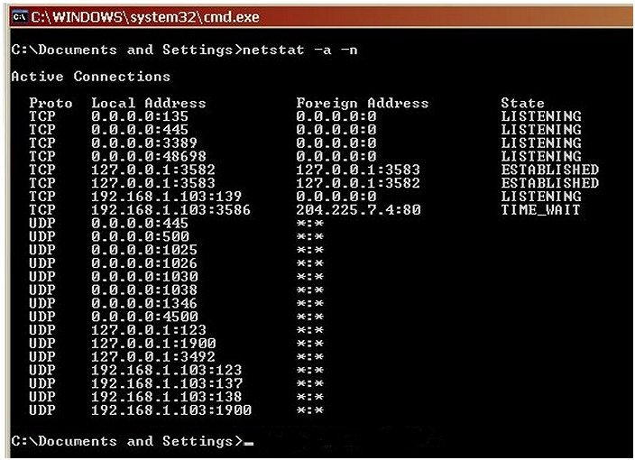
Port Addressing Types and Tools
Source IP
Source Port
Destination IP
Destination Port
TCP/UDP
Netstat - Network Utility Tool
Source Socket
Connection State
Destination Socket
netstat –a –n command

Slide 27
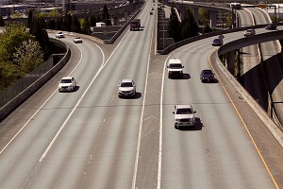



Function 4 –Multiplexing
application
transport
Multiplexing
multiplexing

Slide 28
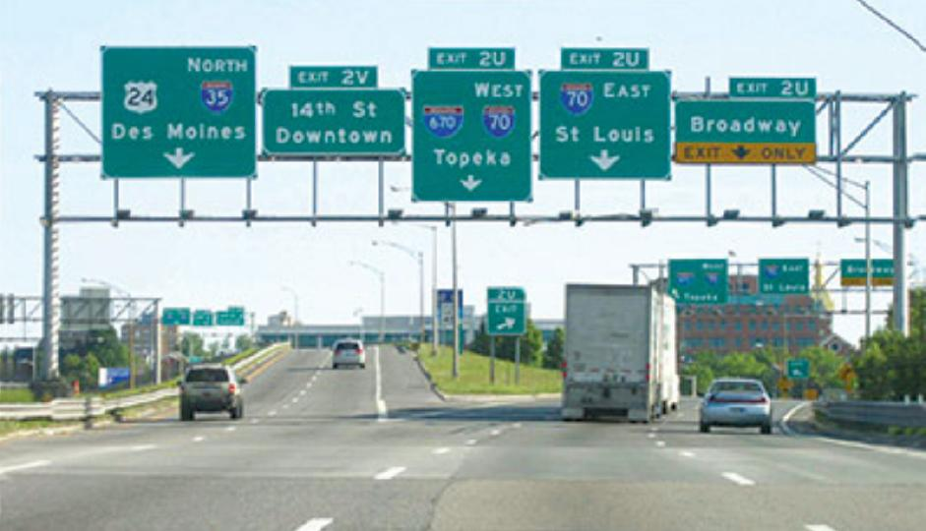
Function 4 –DeMultiplexing
application
?
transport
Demultiplexing
Demultiplexing

Slide 29
DeMultiplexing/ Multiplexing
Multiplexing, demultiplexing: based on segment, datagram header field values
UDP: demultiplexing using destination port number (only)
TCP: demultiplexing using 4-tuple: source and destination IP addresses, and port numbers

Slide 30
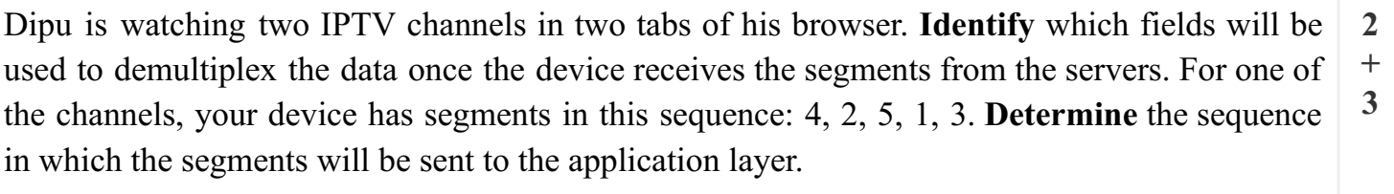
IP & Port address,
As they are received

Slide 31
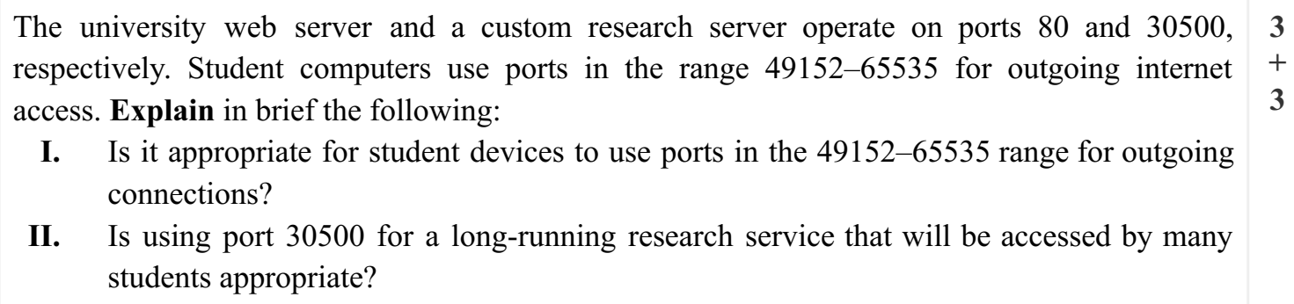
II. For long time use, the students should get the port registered for their server from ICANN.
I. Yes, the given range belongs to the dynamic port addresses class.

Slide 32
And Now more on TCP!

